Slide 1
Traffic accidents
United States

Slide 2
Contents
Introduction
Objectives
Methodology
Results
Discussion
Conclusion
Reference

Slide 3
Introduction
Every year the government builds new roads and highways to be able to accommodate the continuous growth of number of vehicles and drivers. As we keep evolving in our motorways, traffic accidents have become a mayor issue with passing years.
The accidents vary on severity causing material damage and life loss. This increases the pressure on the government from the public to provide better ways to prevent traffic accidents to lower the economic impact they have in society. Therefore, is imperative to find which factors could influence traffic accidents in order to help prevent or lower their severity.
If we can identify factors that are associated with higher severity or higher number of accidents, we could help improve prevention methods and warnings to improve the traffic accident rate.

Slide 4
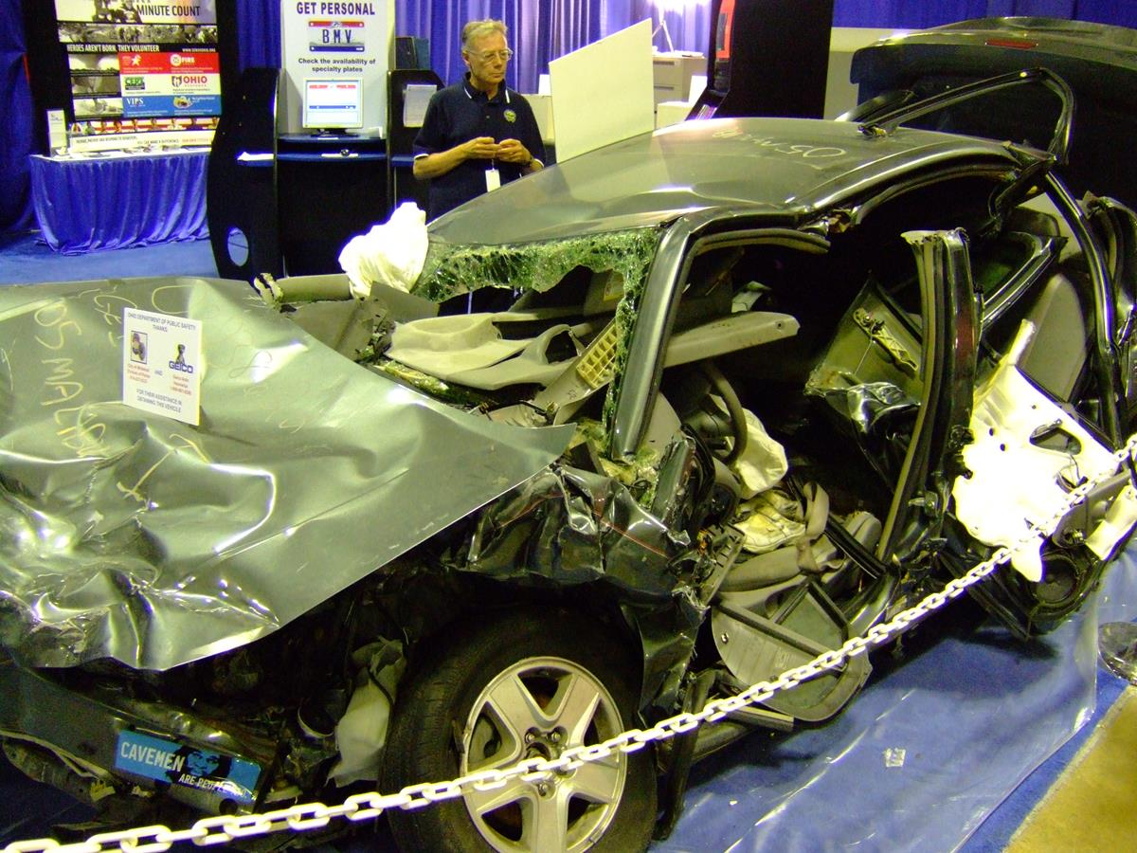
Objectives
Recognize main factors that influence traffic accidents severity.
Recognize main factors that influence prevalence traffic accidents.
Develop a model to aid with prediction of accident severity.
Notes:
Consider talking about:
Human factors
Road design
Vehicle design and maintenance
Sociological factors
Other

Slide 5
Methodology
The dataset used refers to traffic accidents in the United States of America, which covers 49 states. The traffic accident data refers to data collected from February 2016 to June 2020. The dataset contains over 3 million records that contain information about accident severity, location, day-time information, weather conditions and road description/conditions.
Cleaning the data: columns without meaningful insights or with repeated information is removed from dataset (example Precipitation(in) was removed due to over 60% values missing). Rows with missing values were removed from dataset (example .
Objects were standardized to avoid repetition and spelling mistakes.
The evaluation of the data uses correlation methods, graphs, one hot coding, among others. This will allow us to get useful information of where to intervene in order to help prevent accidents.
Last, we created a model to help estimate severity of accident.
Notes:
Consider talking about:
Psychological
Physical

Slide 6
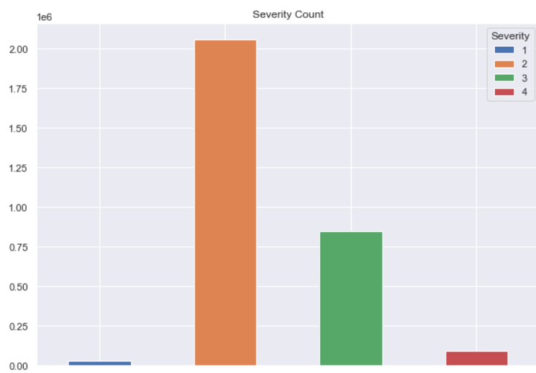
Results
The Severity of accidents seem to have a higher prevalence among Severity type two and lowers significantly to type 3, 4 and lastly type 1.
Notes:
Consider talking about:
United Nations
Collision migration

Slide 7
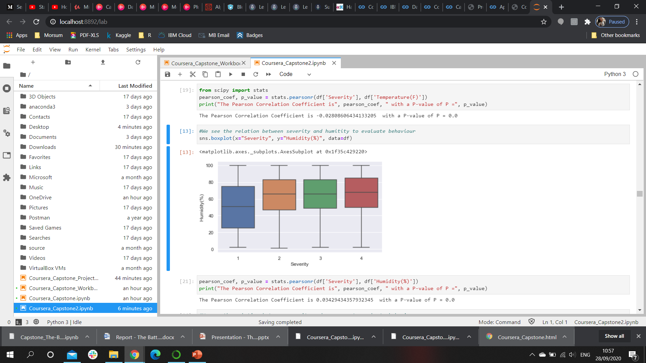
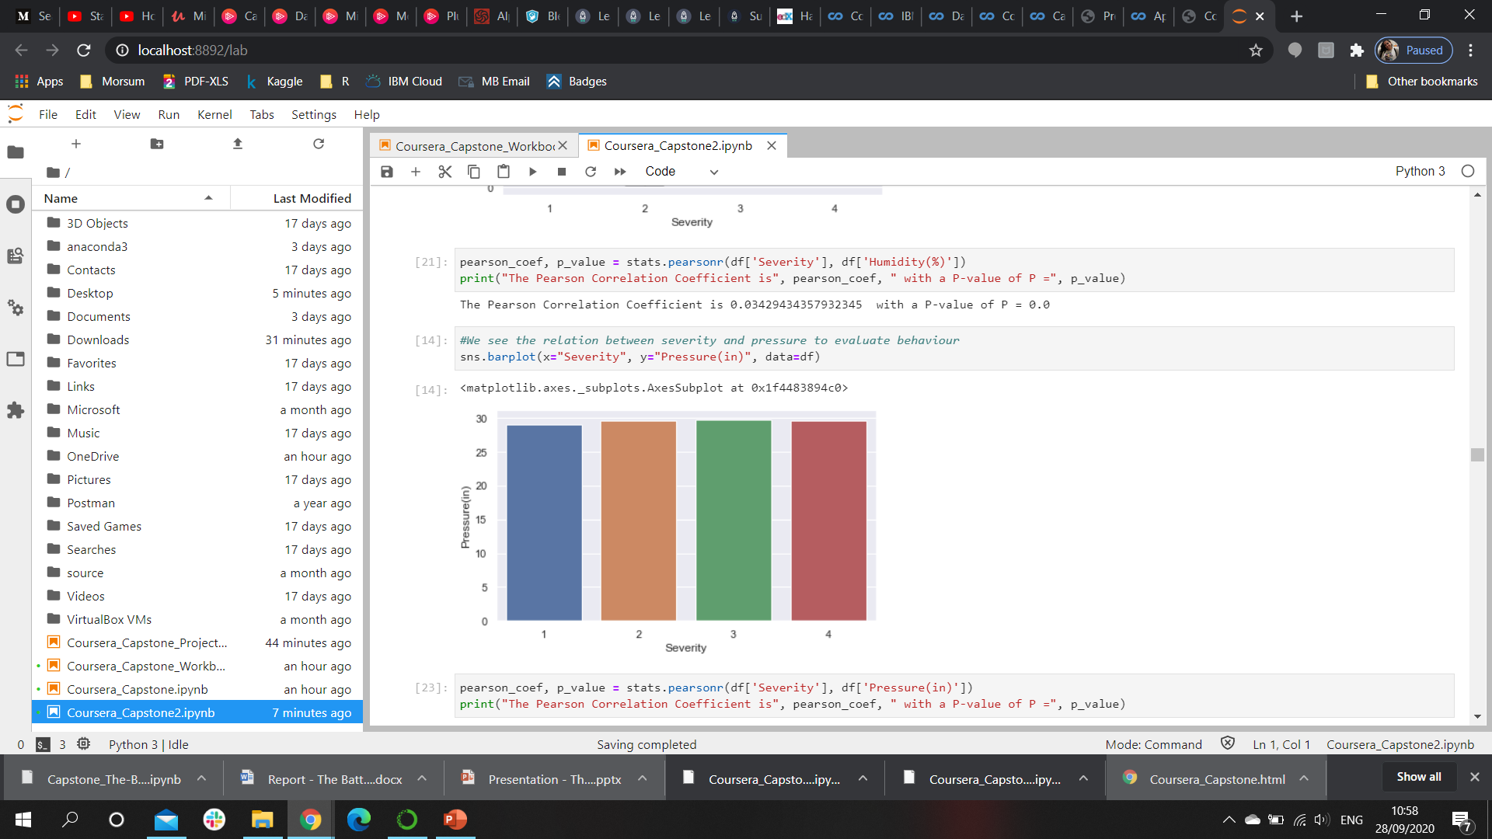
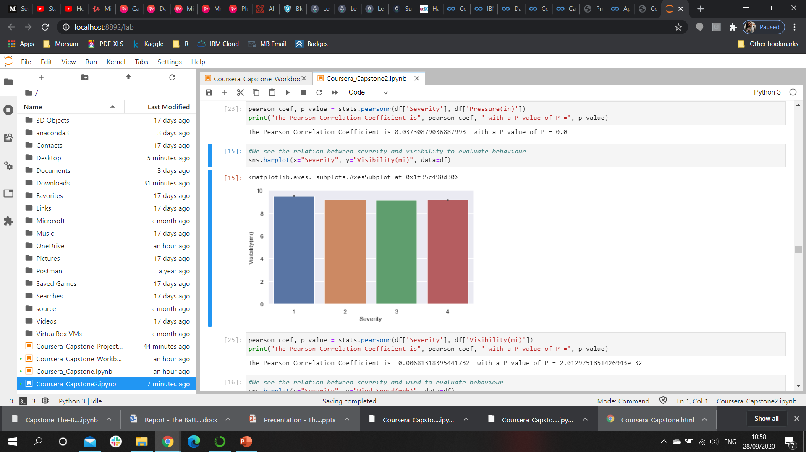
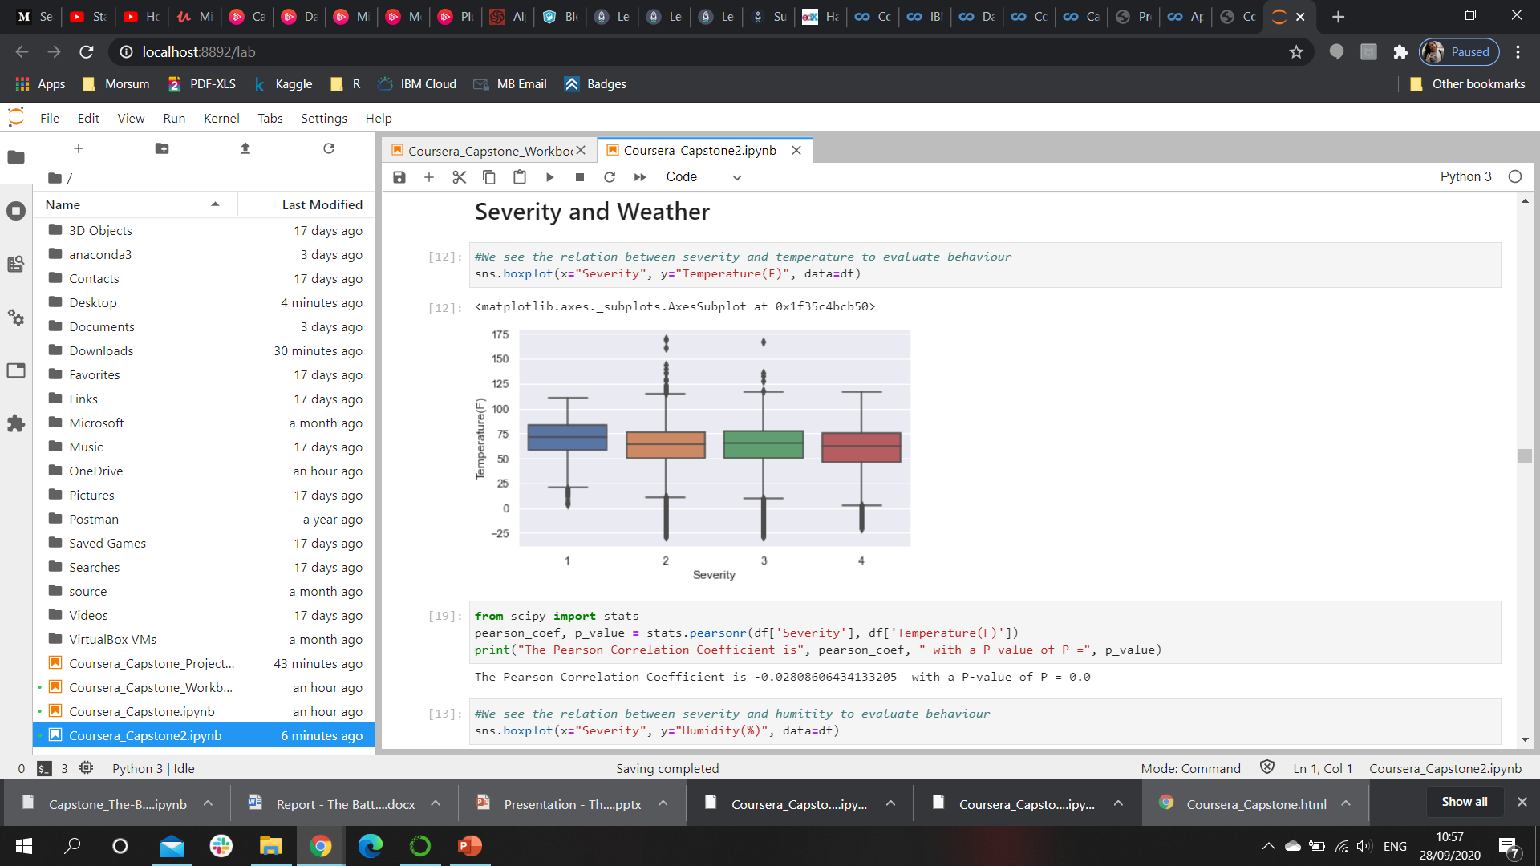
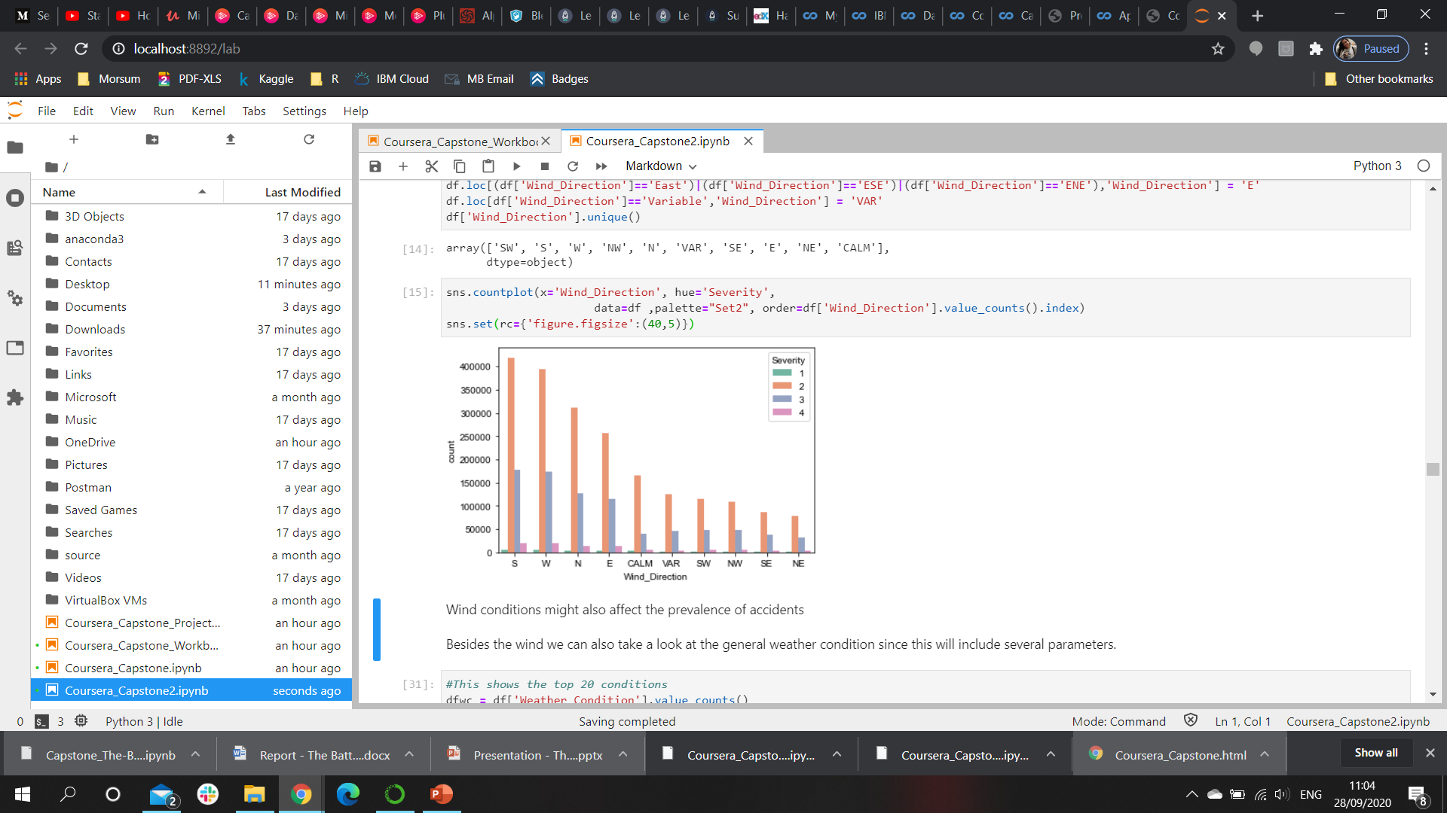
Results Weather
Humidity, Pressure, Visibility and Temperature don’t have a significant correlation with each severity of accident
Wind Direction does seem to have different influence depending on direction even though the significance is weak
Notes:
Consider talking about:
United Nations
Collision migration

Slide 8
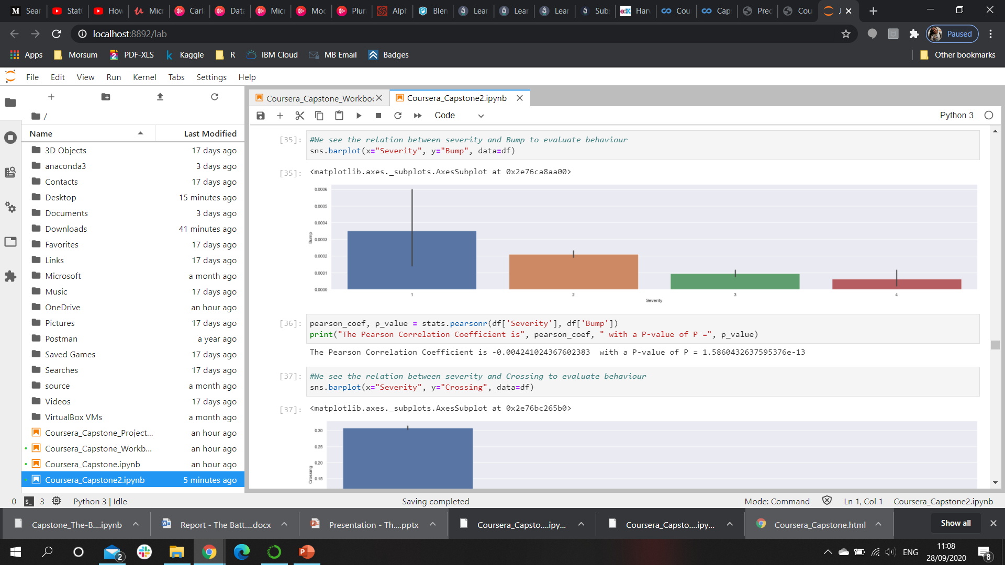
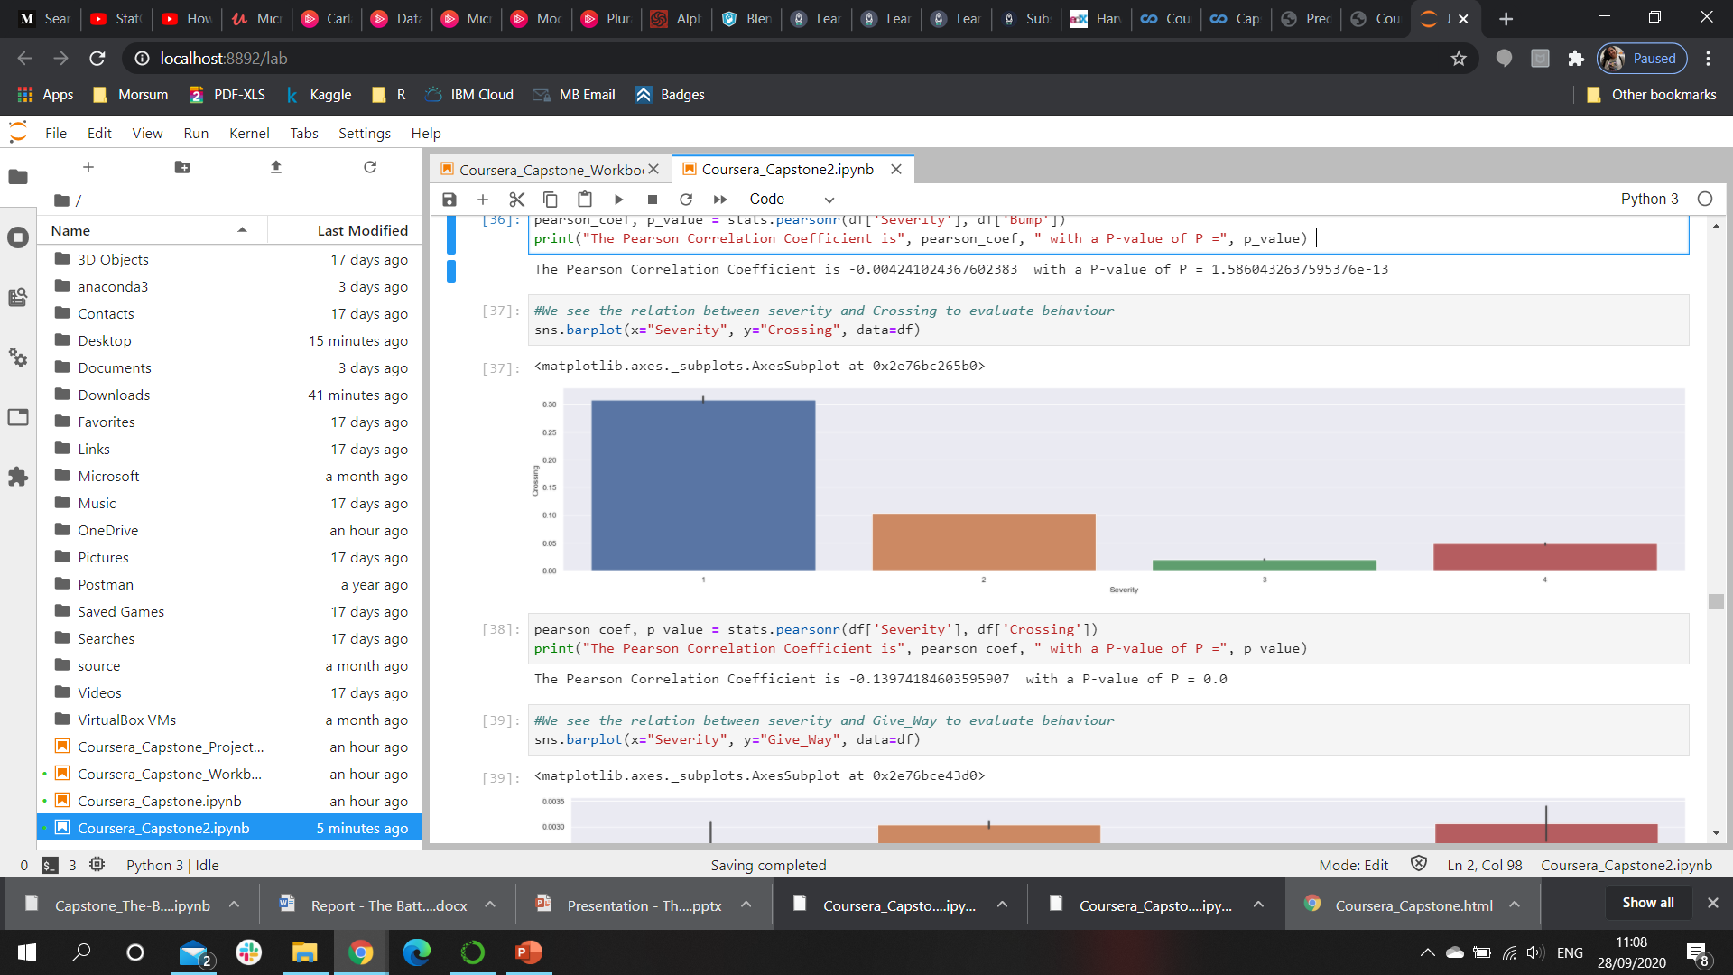
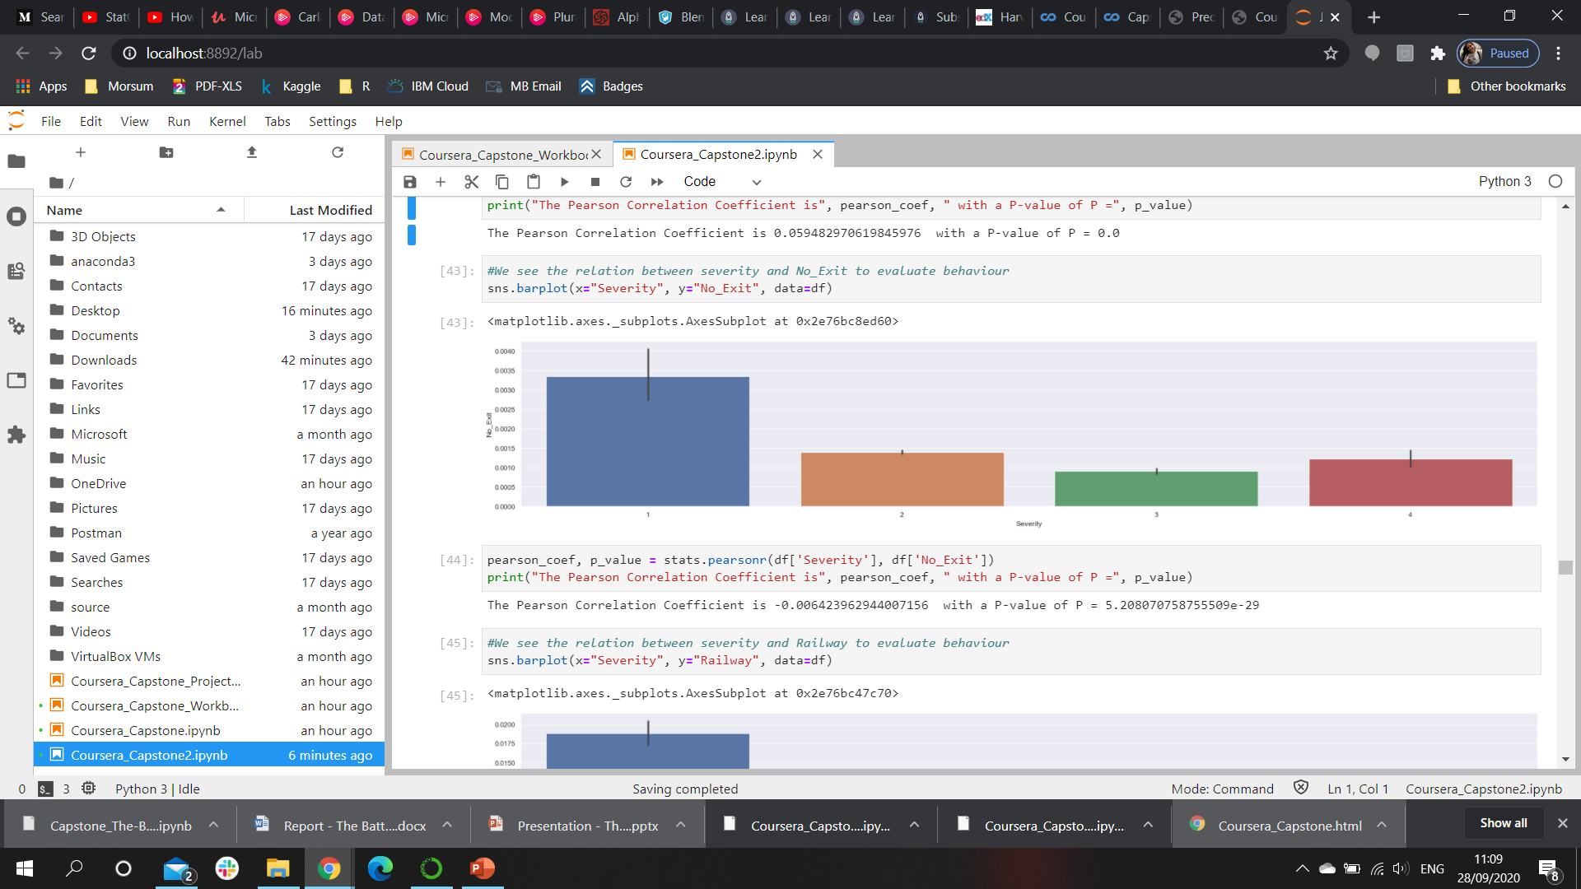
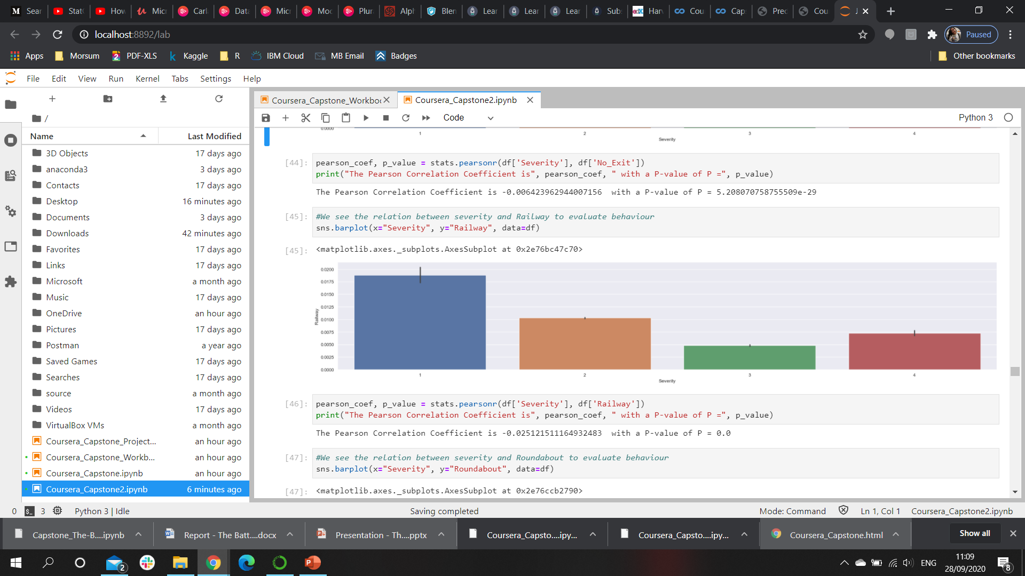
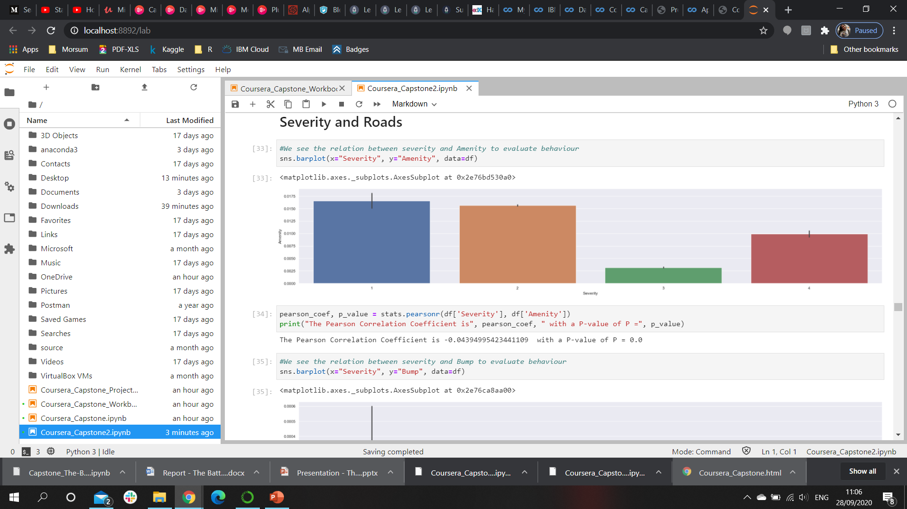
Results Roads
Bump
Crossing
These factors show a higher influence in low severity accidents
No Exit
Railway
Amenity
Notes:
Consider talking about:
United Nations
Collision migration

Slide 9
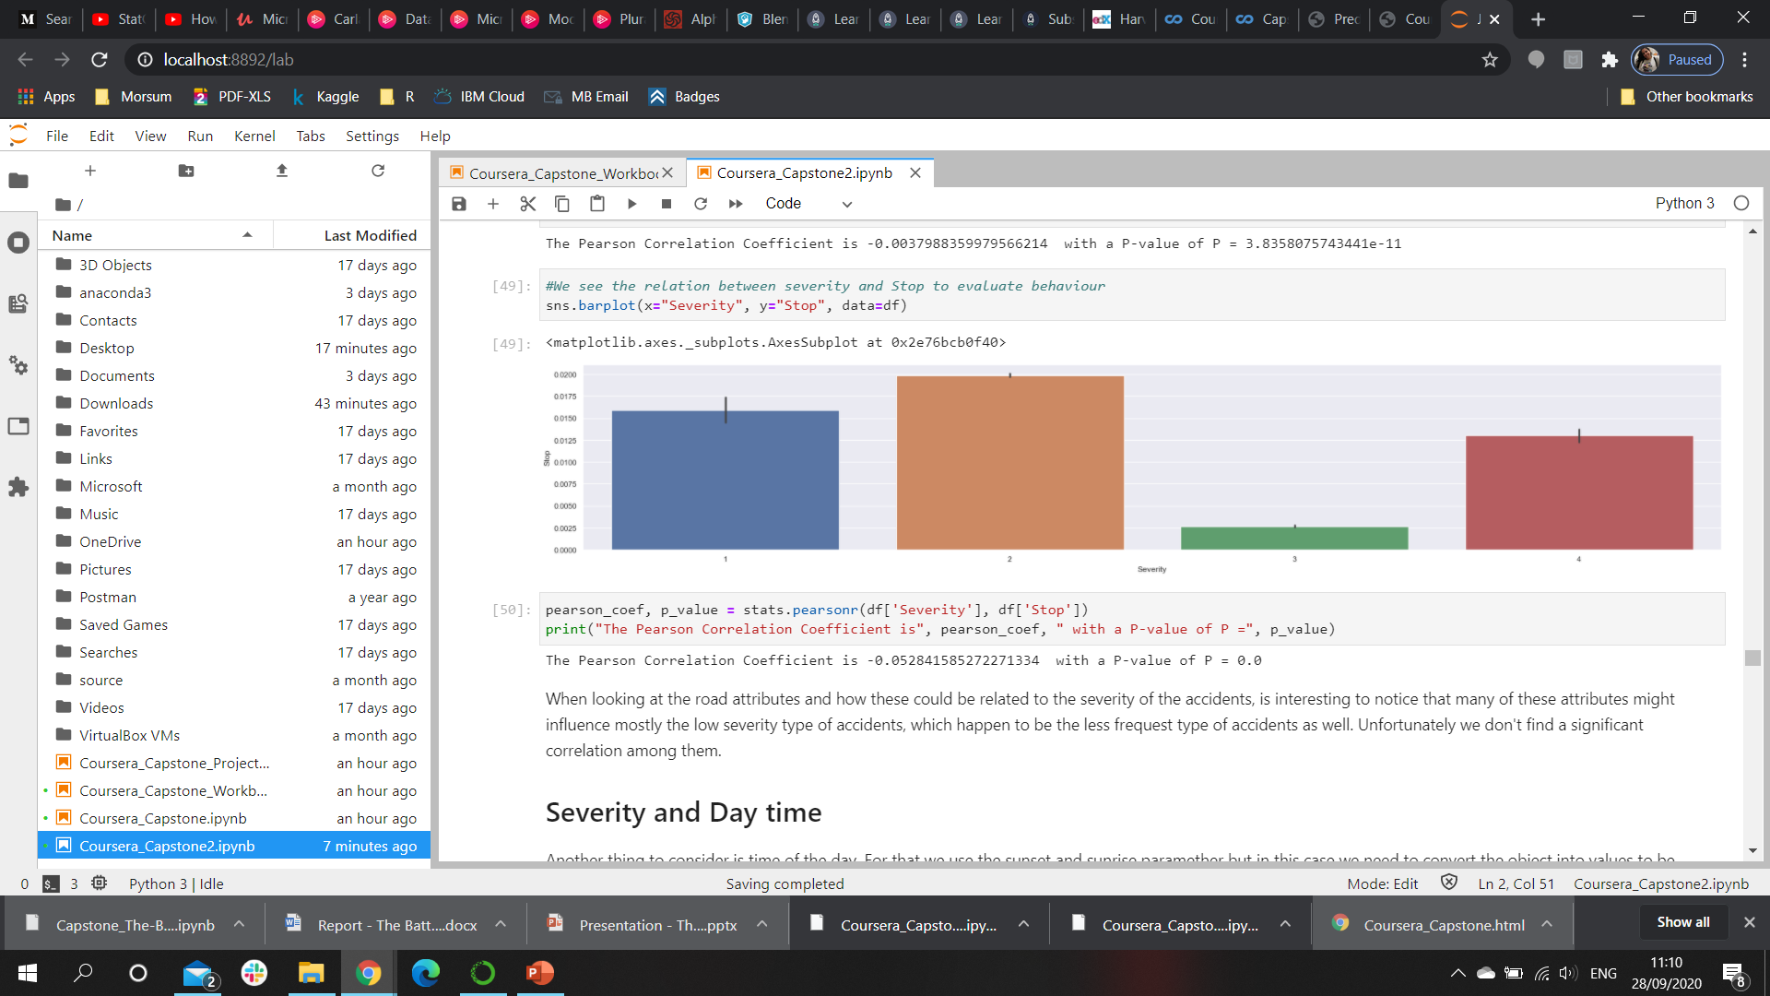
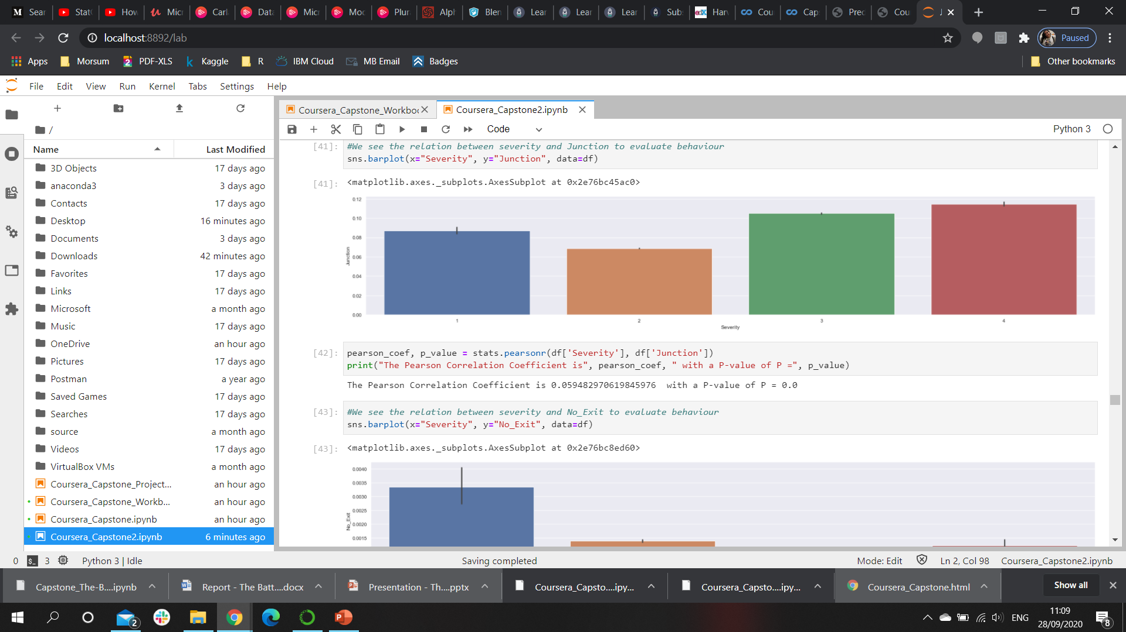
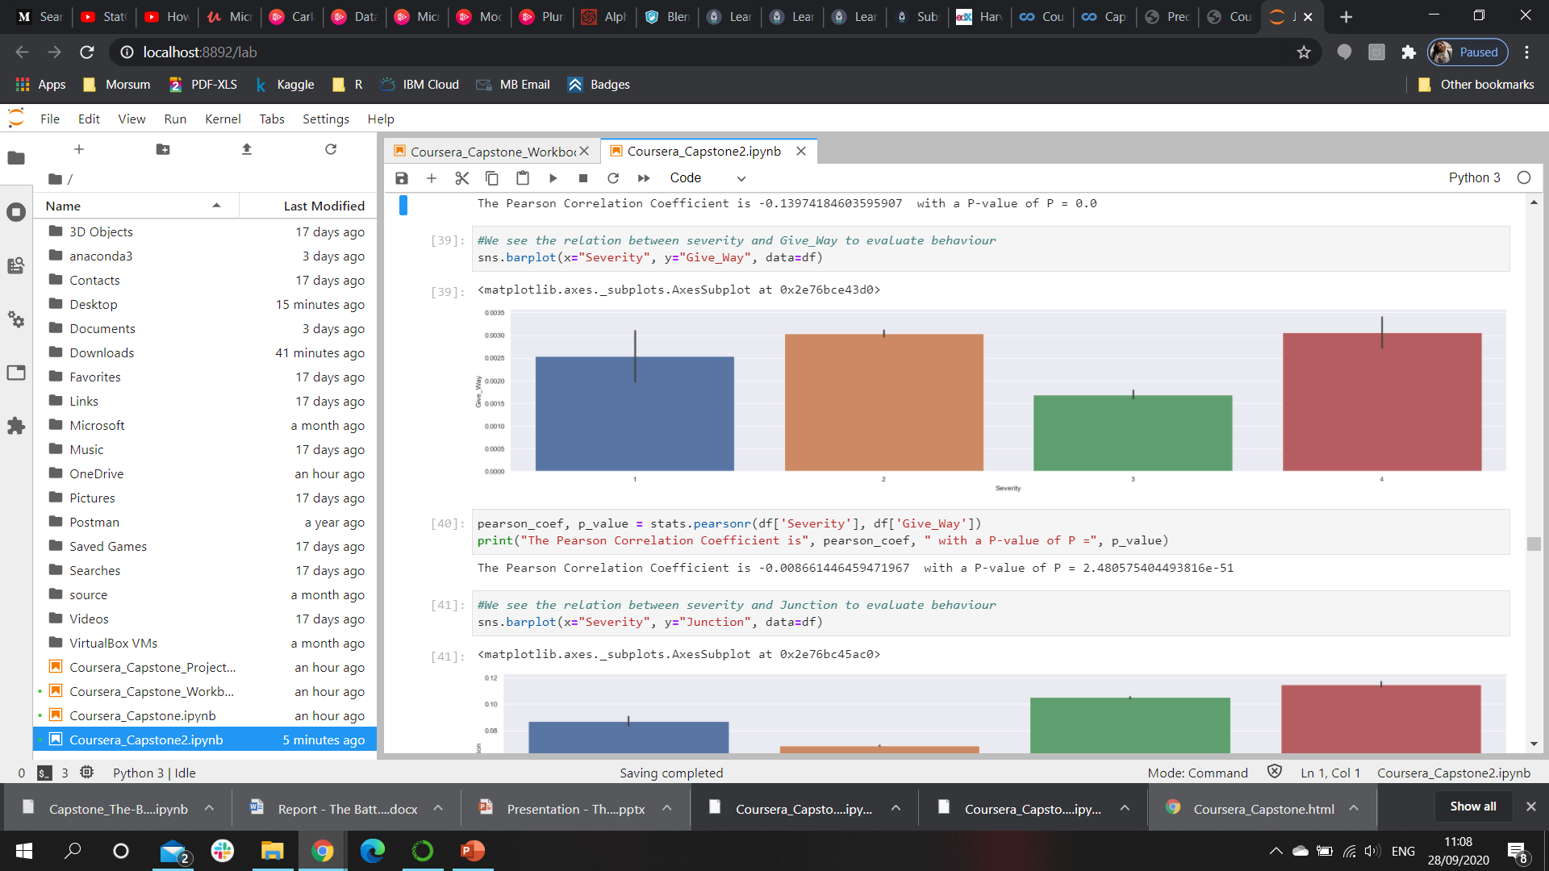
Results Roads
Stop
Junction
These factors show influence in all severity accidents with higher prevalence of high severity accidents
Give Away
Notes:
Consider talking about:
United Nations
Collision migration

Slide 10
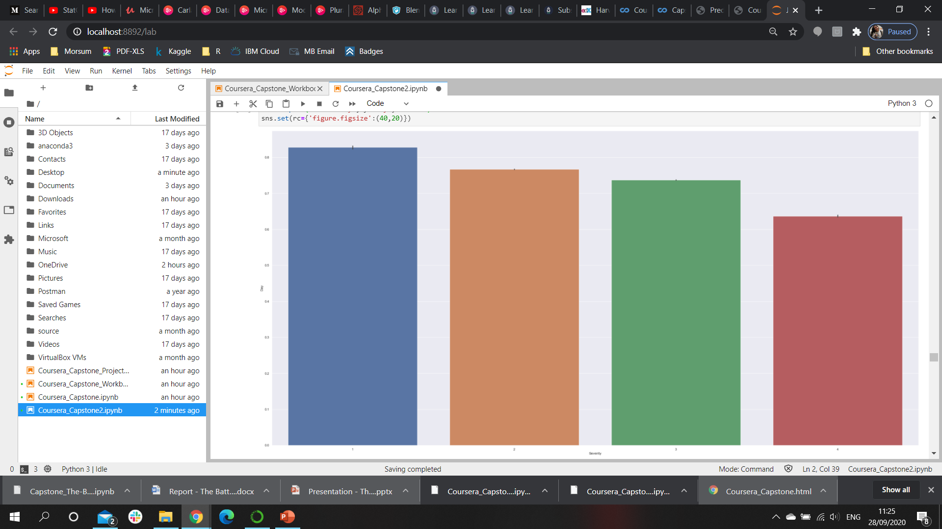
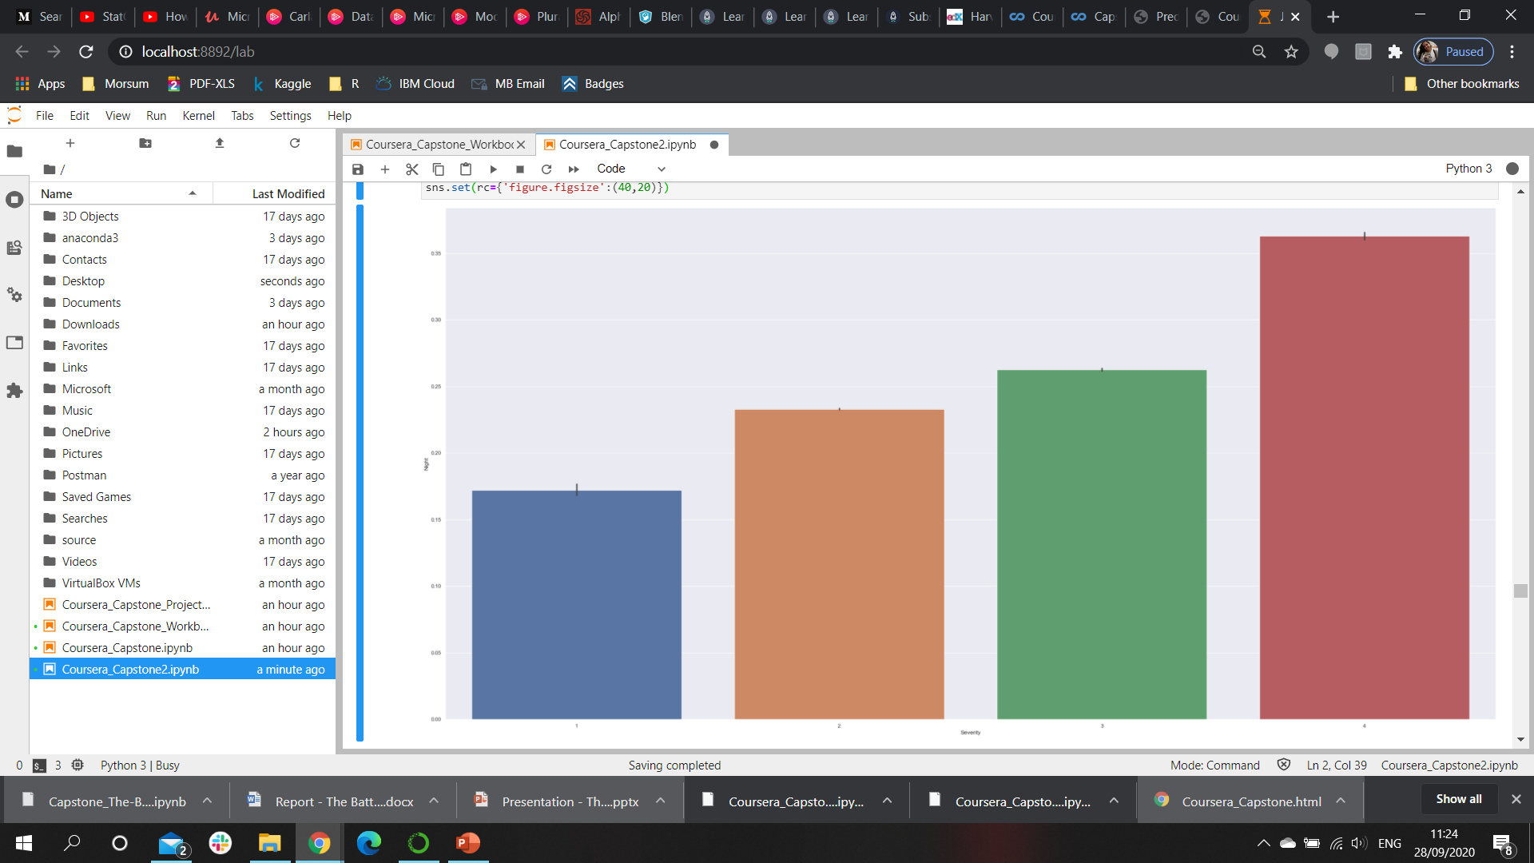
Results Day Time
Day-time number of accidents by severity of accident
There are 2.2 million accidents by day-time in contrast to only 700 thousand during night-time.
The most significant difference is the severity which increases during night-time.
Night-time number of accidents by severity of accident
Notes:
Consider talking about:
United Nations
Collision migration

Slide 11
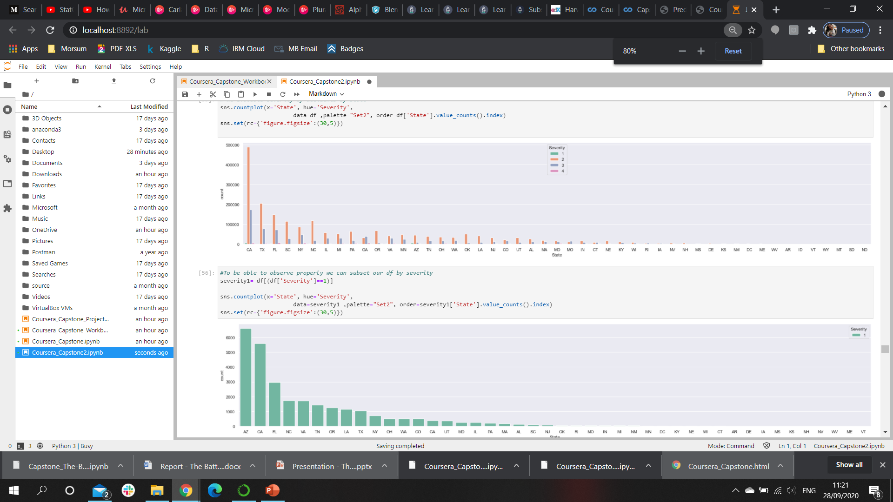
Results Location
Accidents Prevalence and Severity by State
Notes:
Consider talking about:
United Nations
Collision migration

Slide 12
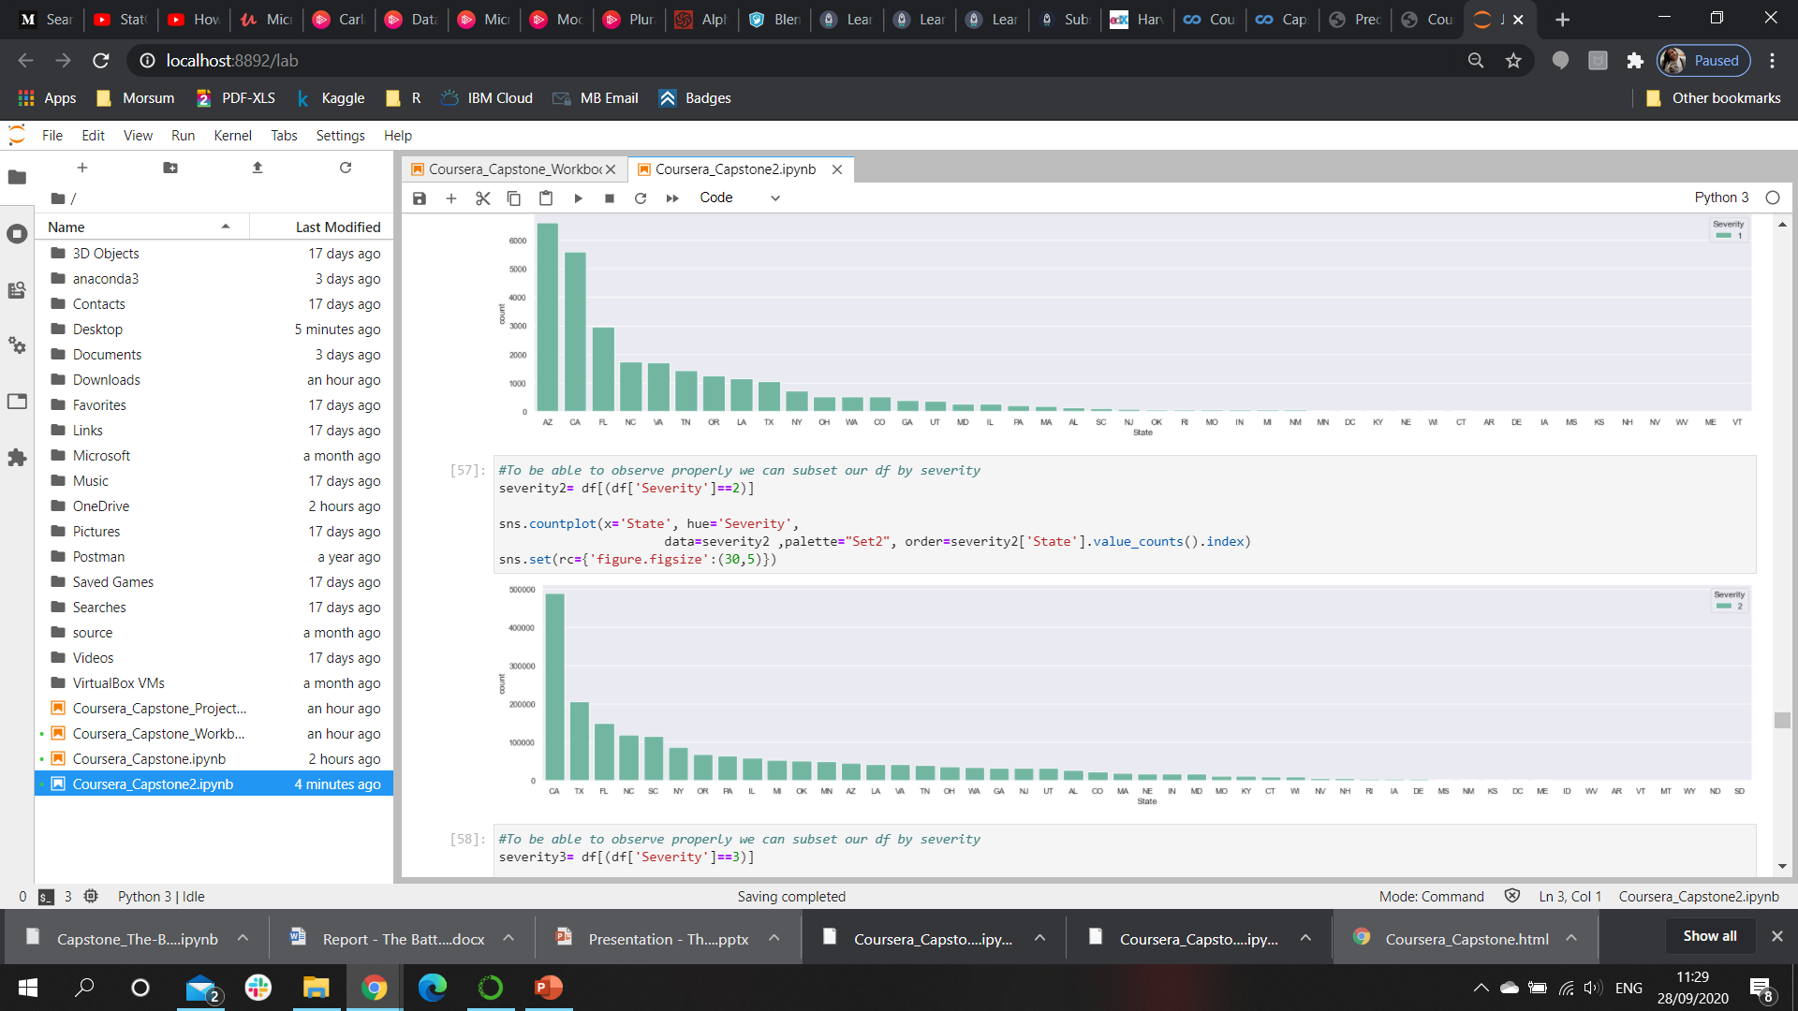
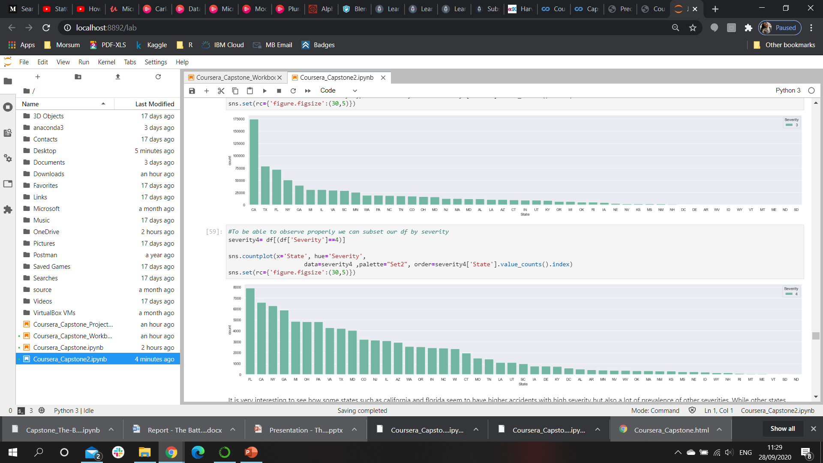
Results Location
Severity 1
Accidents Prevalence and Severity by State.
Note how California and Florida tend to have higher number of accidents with different degrees of severity
Severity 2
Severity 3
Severity 4
Notes:
Consider talking about:
United Nations
Collision migration

Slide 13
Discussion
Some factors are outside of our control such as day-time and weather. However, warnings can be made, and information can be provided to people to help prevent these occurrences. It would also be interesting to find other factors that could influence the night accidents such as speed or driving under the influence to make a more meaningful advice.
Light weather conditions such as cloudy days, light rain and light snow seem to be related with the majority of accidents specially those with lower severity. This seems to support that these occurrences might not be correlated as one would have expected.
One important set of factors are related to roads. We observed how give away, junctions and stops tend to be related with higher severity of accident. Increasing the awareness of these points, by increasing amount of signals, sings and lights that can flag such places would be beneficial to make the driver more conscious about the presence of danger in these areas.
Notes:
Consider talking about:
Crash rates
Fatality

Slide 14
Discussion
Since the prevalence of accidents is not the same across country, it would be extremely beneficial to increase awareness campaigns targeted to those states where the incidence of accidents is higher or where the severity is also higher. States such as California, Texas, Florida, South Carolina, New York and North Carolina should be the first states where these kind of campaigns and even other road measures. The higher severity levels of accidents are observed in some of those states but states such as Georgia, Michigan, Ohio and Pennsylvania should also be included in these campaigns and government road intervention to try to lower the severity and/or occurrence of these kind of accidents.
We have models to help us predict the severity of the occurrence of the accidents. They help to predict the severity 4 with 100% accuracy. Unfortunately they don't have high accuracy (only 71%) when testing on new data if we want to predict all possible severity. Other models or more data might be needed.
Notes:
Consider talking about:
Crash rates
Fatality

Slide 15
Conclusion
Location and road conditions tend to have a big impact on the prevalence of accidents and the severity of the same. We can target such places by increasing awareness and promoting the improvement of such areas.
The government can start targeting higher risk states to lower severity and number of cases. With our analysis we can direct the effort to more specific road factors and locations making this a great aid on decision making.
We always must keep in mind that human behavior and other factors which are not considered in this data set might also play a very important role in determine the occurrence of these accidents. More studies including other variables such as speed, age, driving under influence among others should be considered to improve the levels of prediction.

Slide 16
Reference
https://www.kaggle.com/sobhanmoosavi/us-accidents
Notes:
Consider talking about:
Economic costs
Legal consequences
Art

